Slide 1

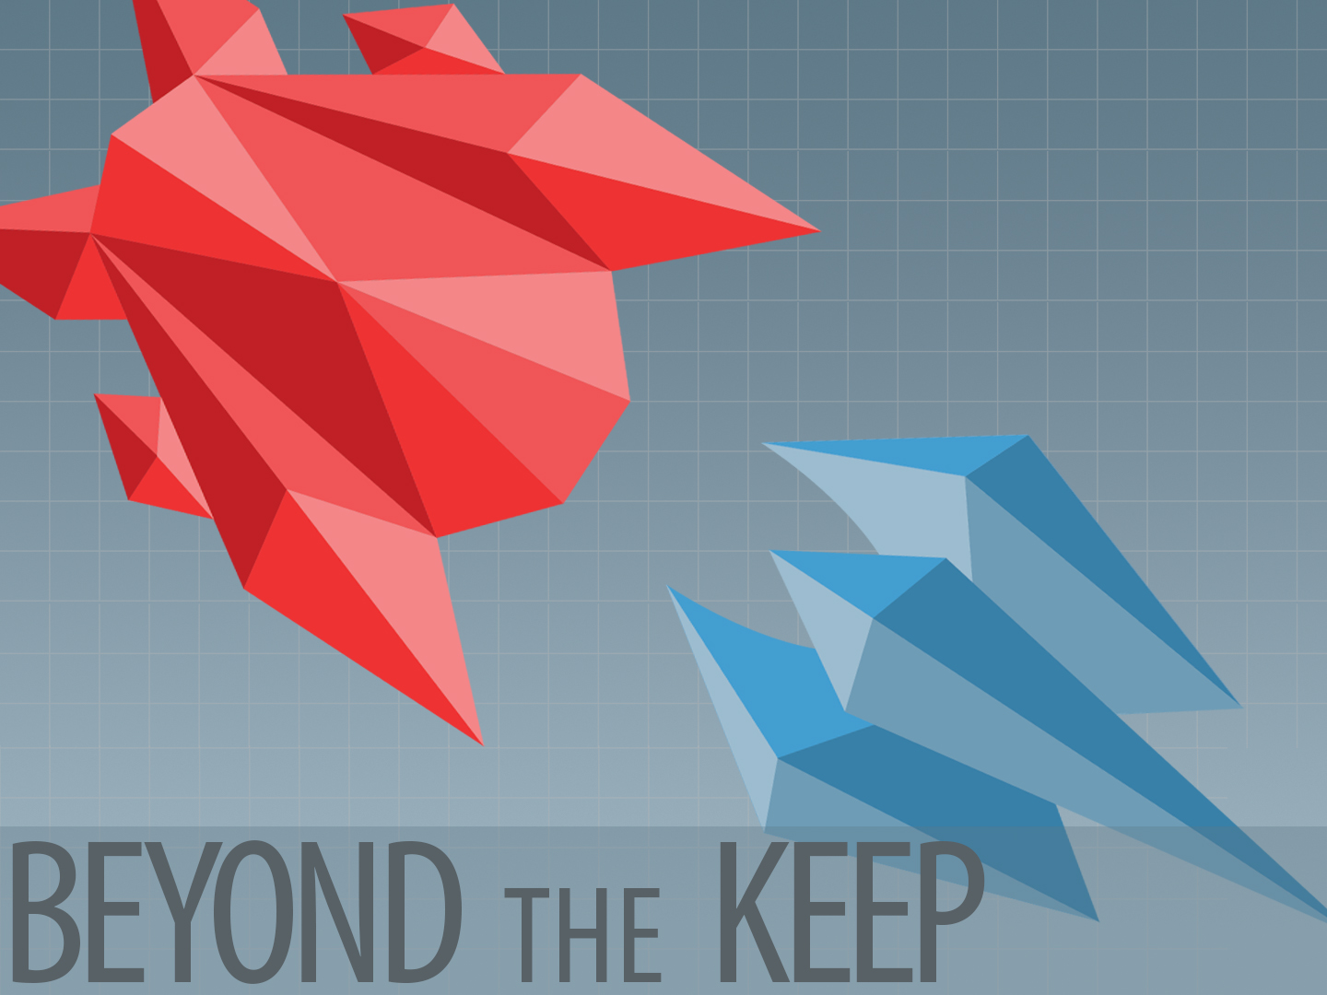

Slide 2
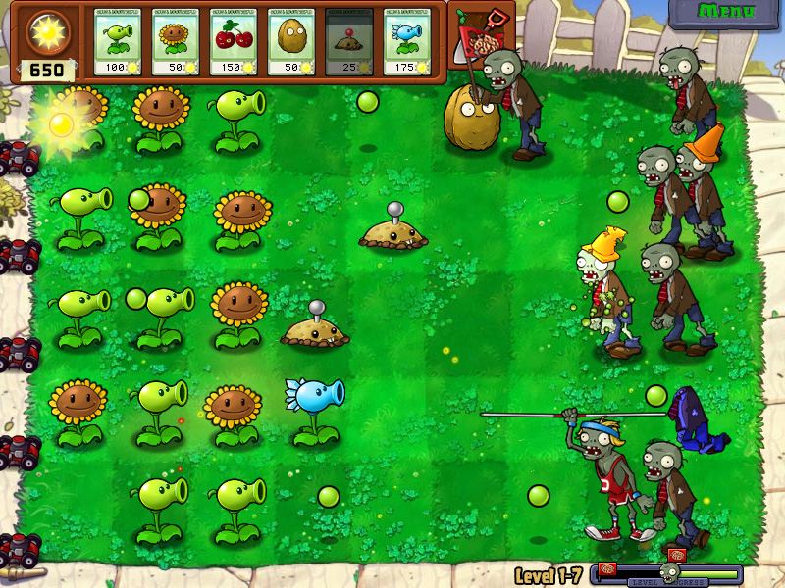
*Popcap’s Plants Vs Zombies

Slide 3
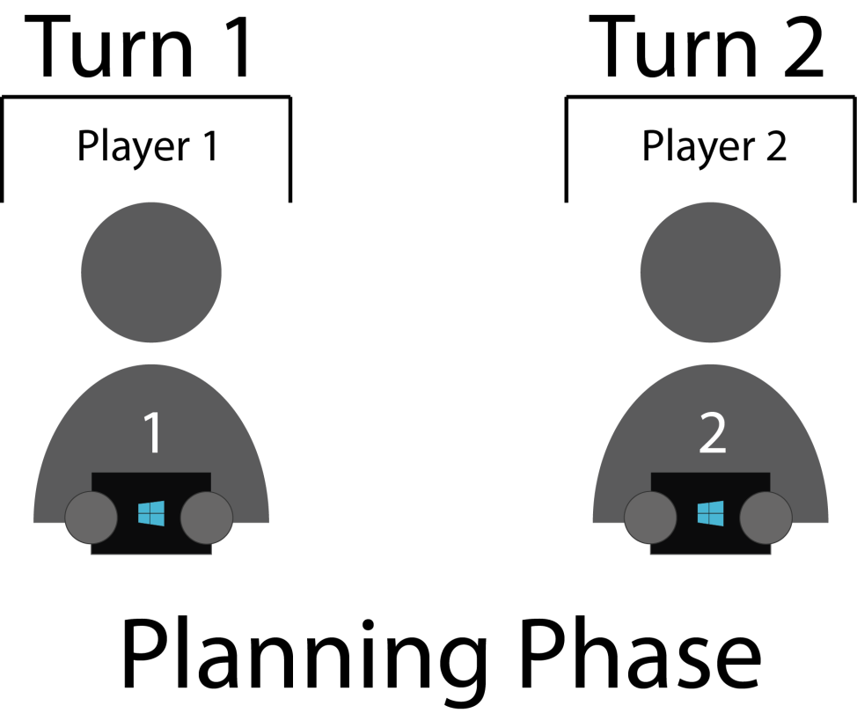
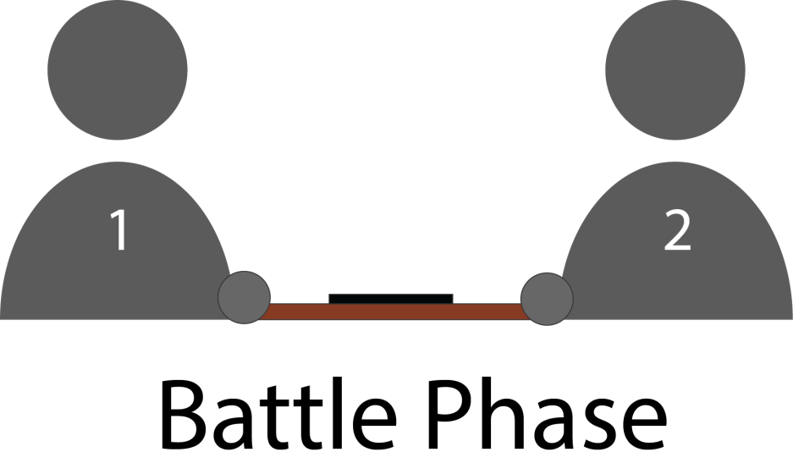

Slide 4
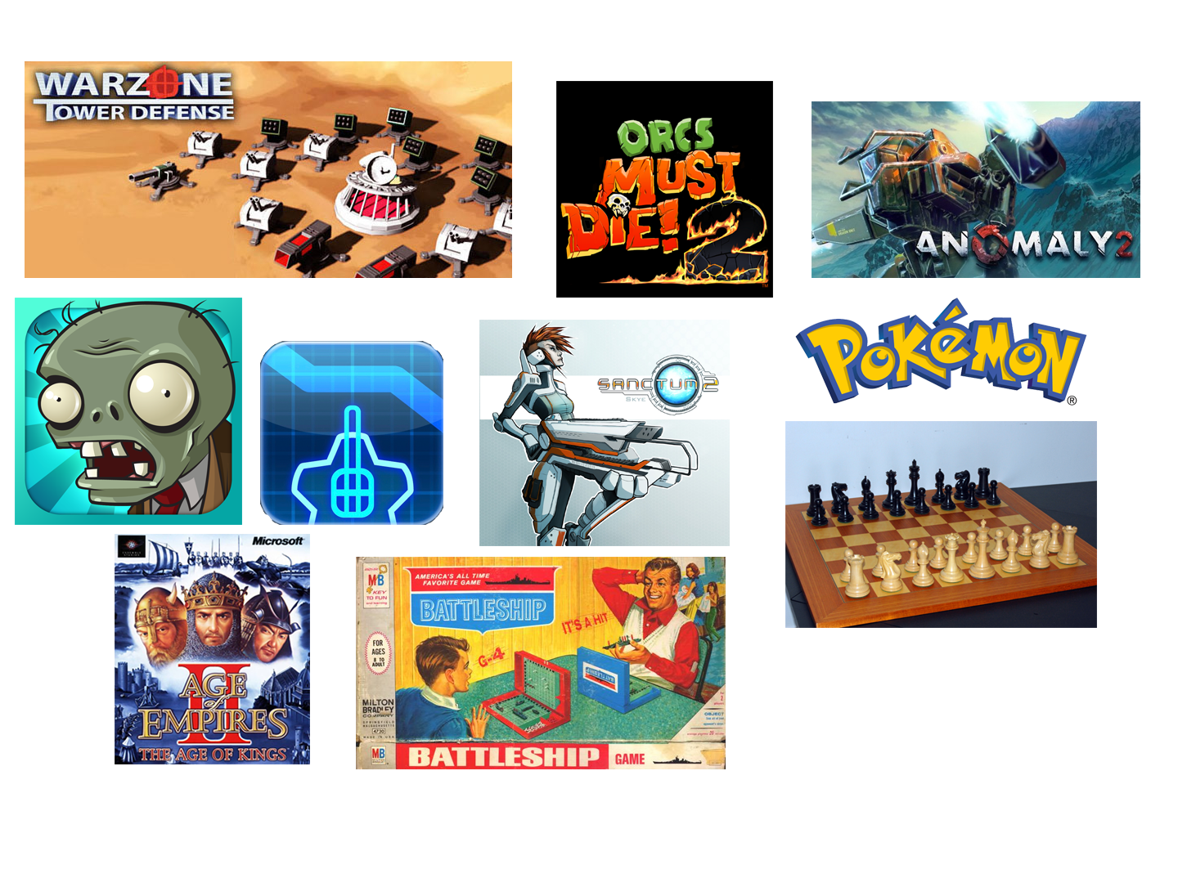


Slide 5

A proven & popular genre on mobile
Plants vs. Zombies
300,000+ sales in first week on iOS, 500,000+ lifetime on Android
GeoDefence
Field Runners
Kingdom Rush
Target Demographic:
8+
Fans of local multiplayer!

Slide 6
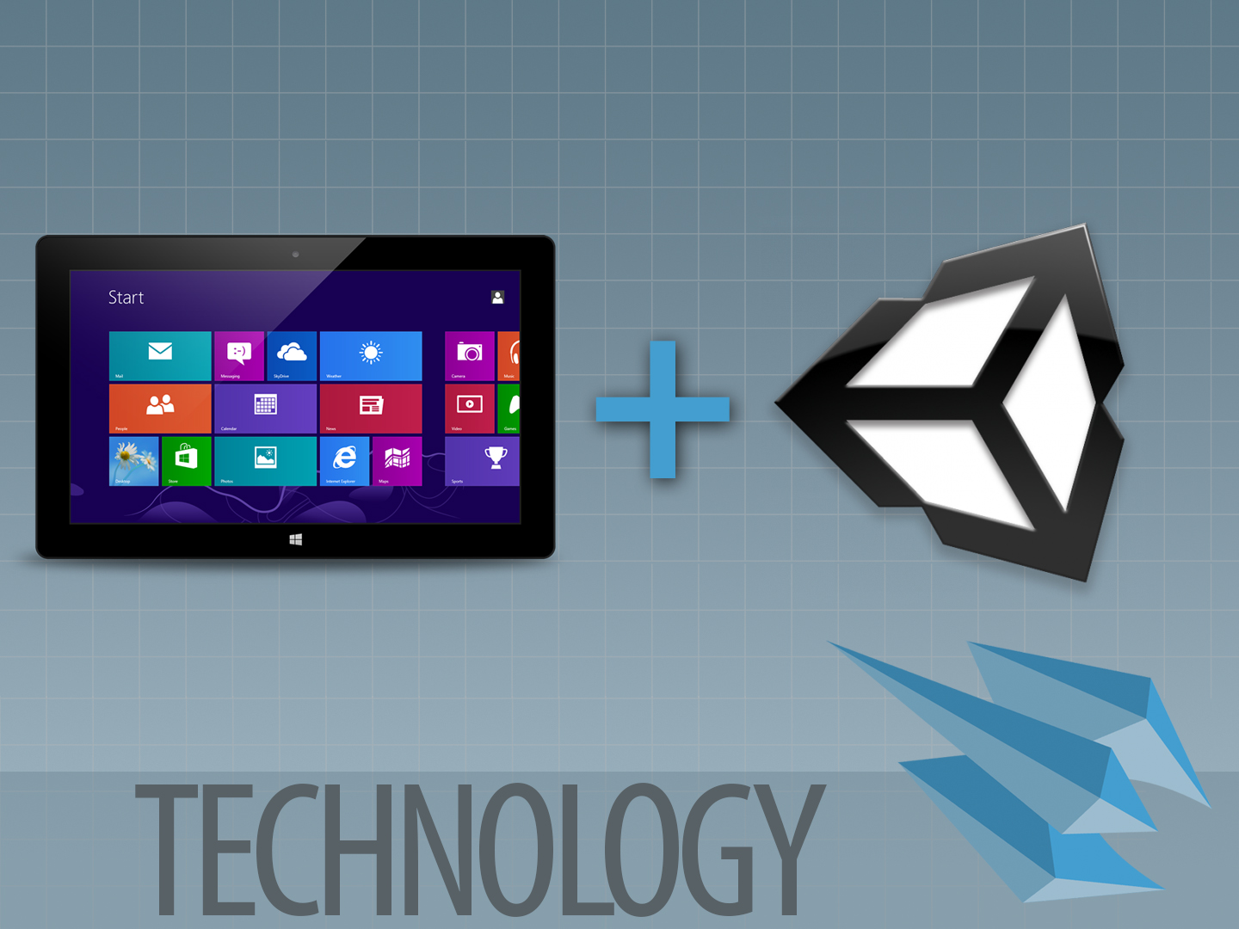

Slide 7


Monetization Model
Aesthetic Customization
Add on Packs (More Towers, More Minions)
Add on packs are shared by both sides! Ensuring no one is ever at a disadvantage.
Social Integration
Stat Tracking and Tournament Mode.
Uses Facebook or Twitter name and profile picture for identification.
Share screenshots with your friends!

Slide 8


Prototype
Proof of concept built in Processing
Alpha:
Feature complete version of game in Unity
Beta:
Balancing, Testing, and Polishing on mobile platform
Gold:
COMPLETE!

Slide 9


Thanks for Listening!

